Slide 1

The
Traveling Salesman Problem,
Genetic Algorithms,
and Ant Colony Optimization
Adam Byerly
adam@rokrol.com
(309) 369-9257

Slide 2

The Traveling Salesman Problem
The TSP is worth studying because it is a good analog for a broad group of real world problems including planning, logistics, microchip manufacturing, and DNA sequencing [1].
"...one of the most famous and important combinatorial-optimization problems..."
[1] Applegate, David L. The Traveling Salesman Problem: A Computational Study. Princeton: Princeton UP, 2006.

Slide 3
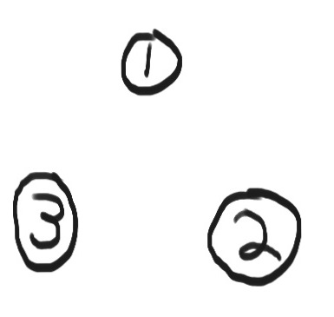
The Traveling Salesman Problem

Slide 4
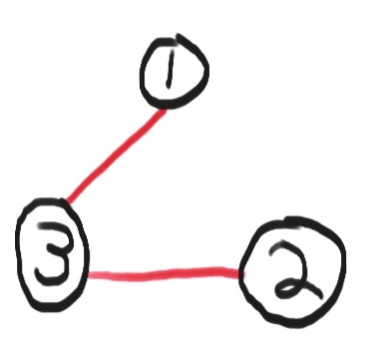
The Traveling Salesman Problem

Slide 5
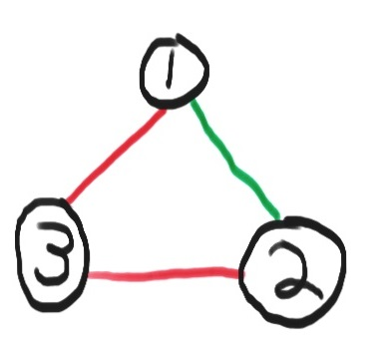
The Traveling Salesman Problem

Slide 6
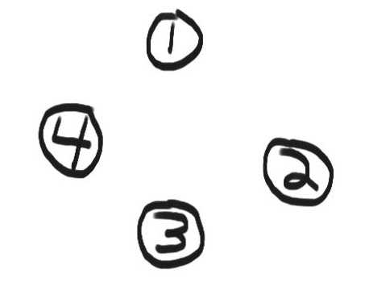
The Traveling Salesman Problem

Slide 7
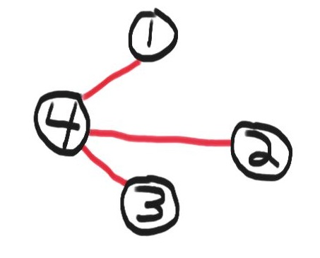
The Traveling Salesman Problem

Slide 8
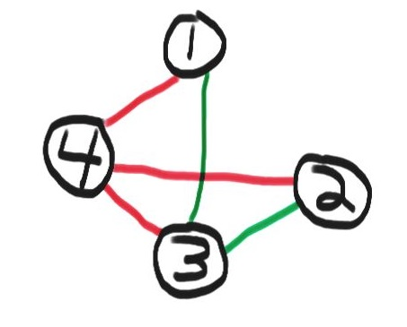
The Traveling Salesman Problem

Slide 9
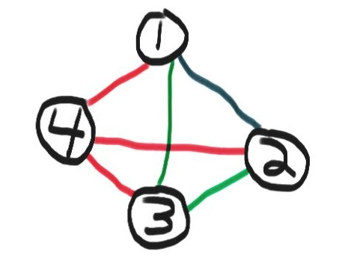
The Traveling Salesman Problem

Slide 10
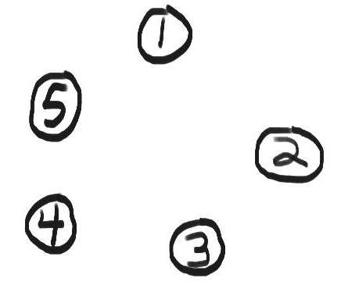
The Traveling Salesman Problem

Slide 11
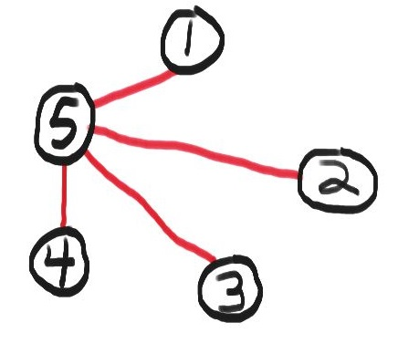
The Traveling Salesman Problem

Slide 12
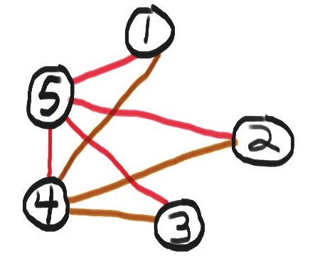
The Traveling Salesman Problem

Slide 13
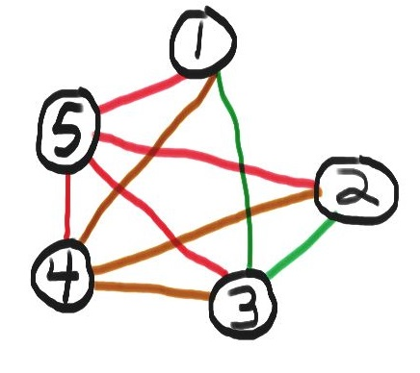
The Traveling Salesman Problem

Slide 14
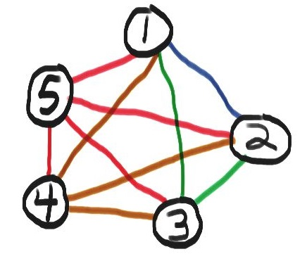
The Traveling Salesman Problem

Slide 15
The Traveling Salesman Problem
The number of edges grows fast!

Slide 16
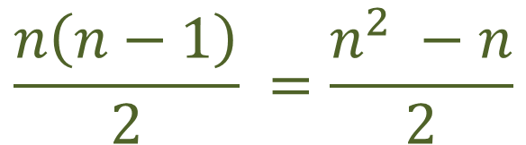

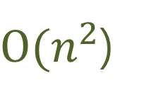
The Traveling Salesman Problem
The number of edges grows fast!
Where $n$ is the number of cities:
$$\frac{n\left(n−1\right)}{2} =\frac{n^{2} −n}{2}$$
$O(n^{2}$)

Slide 17
The Traveling Salesman Problem
But that’s edges.
The number of possible tours the salesman can take
is worse!

Slide 18
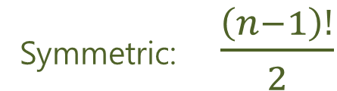

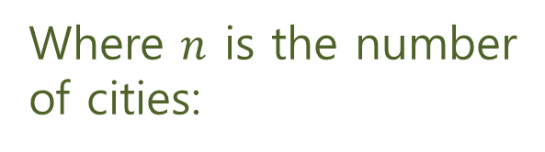
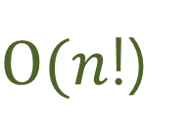
The Traveling Salesman Problem
But that’s edges.
The number of possible tours the salesman can take
is worse!
Where $n$ is the number
of cities:
Symmetric: $\frac{\left(n−1\right)!}{2}$
Asymmetric: $\left(n−1\right)!$
$O(n$!)

Slide 19
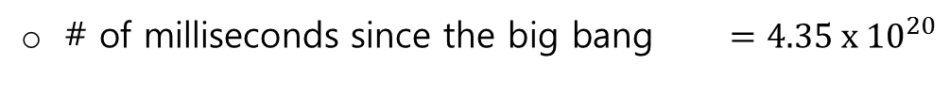
The Traveling Salesman Problem
# of milliseconds since the big bang $=4.35 x {10}^{20}$

Slide 20
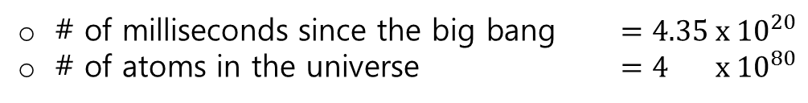
The Traveling Salesman Problem
# of milliseconds since the big bang $=4.35 x {10}^{20}$
# of atoms in the universe $=4 x {10}^{80}$

Slide 21
The Traveling Salesman Problem
# of milliseconds since the big bang $=4.35 x {10}^{20}$
# of atoms in the universe $=4 x {10}^{80}$
Cities in U.S. with 500 or more residents $=13,509$

Slide 22
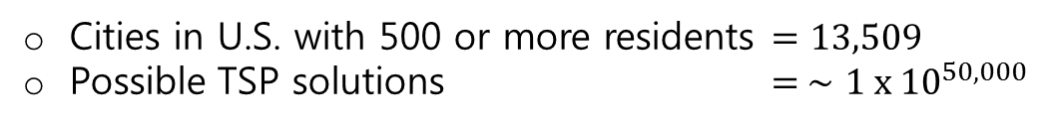
The Traveling Salesman Problem
# of milliseconds since the big bang $=4.35 x {10}^{20}$
# of atoms in the universe $=4 x {10}^{80}$
Cities in U.S. with 500 or more residents $=13,509$
Possible TSP solutions $= ∼1 x {10}^{50,000}$

Slide 23
The Traveling Salesman Problem
# of milliseconds since the big bang $=4.35 x {10}^{20}$
# of atoms in the universe $=4 x {10}^{80}$
Cities in U.S. with 500 or more residents $=13,509$
Possible TSP solutions $= ∼1 x {10}^{50,000}$
n | n! |  | n | n!
1 | 1 |  | 13 | 6227020800
2 | 2 |  | 14 | 87178291200
3 | 6 |  | 15 | 1307674368000
4 | 24 |  | 16 | 20922789888000
5 | 120 |  | 17 | 355687428096000
6 | 720 |  | 18 | 6402373705728000
7 | 5040 |  | 19 | 121645100408832000
8 | 40320 |  | 20 | 2432902008176640000
9 | 362880 |  | 25 | 1.551121004×10²⁵
10 | 3628800 |  | 50 | 3.041409320×10⁶⁴
11 | 39916800 |  | 70 | 1.197857167×10¹⁰⁰

Slide 24
The Traveling Salesman Problem
It’s Really Hard!
The optimization problem is NP-Hard
The decision version is NP-Complete
The complexity class is the same:
For symmetric and asymmetric versions
Whether or not the salesman returns to the starting city

Slide 25
The Traveling Salesman Problem
There are branch and bound methods that for certain instances of the TSP, we can get a deterministic answer before the end of the universe.
But in general, we cannot solve arbitrary, non-trivial instances of the TSP.

Slide 26
The Traveling Salesman Problem
There are branch and bound methods that for certain instances of the TSP, we can get a deterministic answer before the end of the universe.
But in general, we cannot solve arbitrary, non-trivial instances of the TSP.
(Unless it turns out that P = NP …the world will get weird in that case…)

Slide 27
The Traveling Salesman Problem
There are branch and bound methods that for certain instances of the TSP, we can get a deterministic answer before the end of the universe.
But in general, we cannot solve arbitrary, non-trivial instances of the TSP.
We call this property of a problem “intractability”.
(Unless it turns out that P = NP …the world will get weird in that case…)

Slide 28
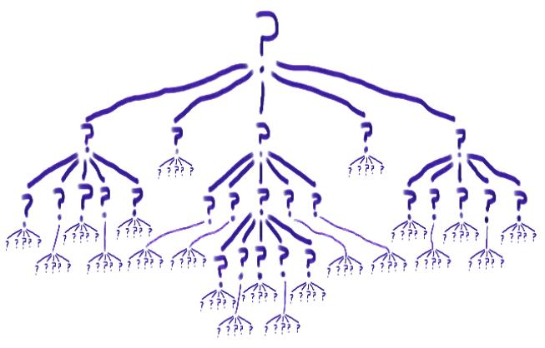
The Traveling Salesman Problem

Slide 29
The Traveling Salesman Problem
This is why we need AI!

Slide 30
The Traveling Salesman Problem
This is why we need AI!
To search a subset of, rather than the entire, solution space. In an “intelligent” fashion.

Slide 31

The Traveling Salesman Problem
This is why we need AI!
To search a subset of, rather than the entire, solution space. In an “intelligent” fashion.

Slide 32

Artificial Intelligence
AI, very informally, is reaching “near optimal” or “good enough” solutions in a “reasonable” amount of time.

Slide 33
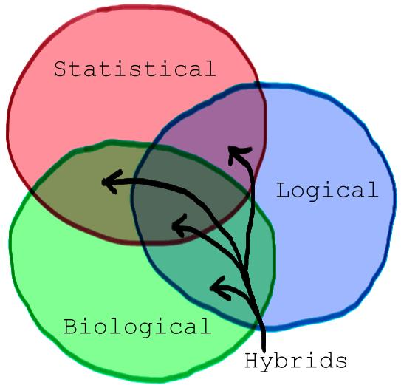
Artificial Intelligence
AI Families

Slide 34
Artificial Intelligence
AI Families
Logical – Expert Systems
Statistical – Regression, Clustering, Bayesian Methods, Markov Chains
Biologically Inspired – Artificial Neural Networks, Genetic Algorithms

Slide 35
Artificial Intelligence
Hybrids
Fuzzy Logic – part logical, part statistical
Ant Colony and Swarm algorithms – mostly biologically inspired, but involves statistics and heuristics

Slide 36
Artificial Intelligence
AI Families

Slide 37
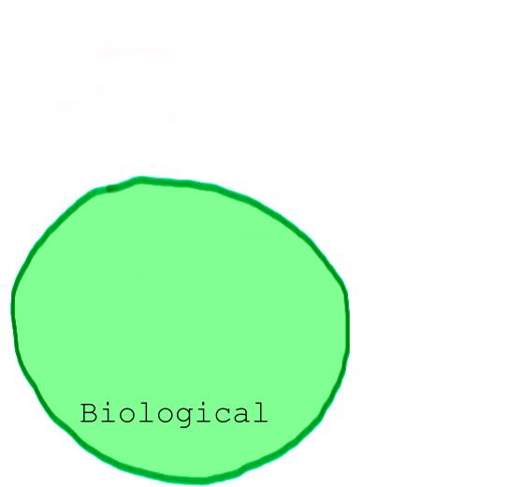
Artificial Intelligence
AI Families

Slide 38
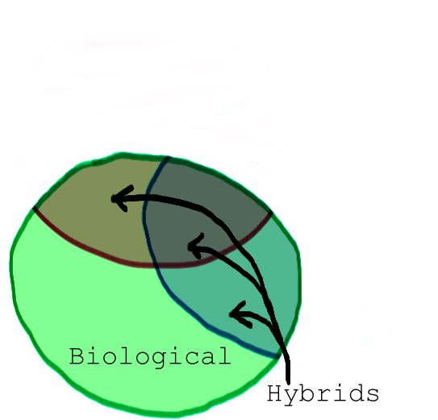
Artificial Intelligence
AI Families

Slide 39
Artificial Intelligence
John Henry Holland
Adaptation in Natural and Artificial Systems (1975, MIT Press)
Introduced the world to Genetic Algorithms
(Tho, others had done some primitive work, including Alan Turing, who in 1950 contemplated a “learning machine” based on evolutionary principles.)

Slide 40
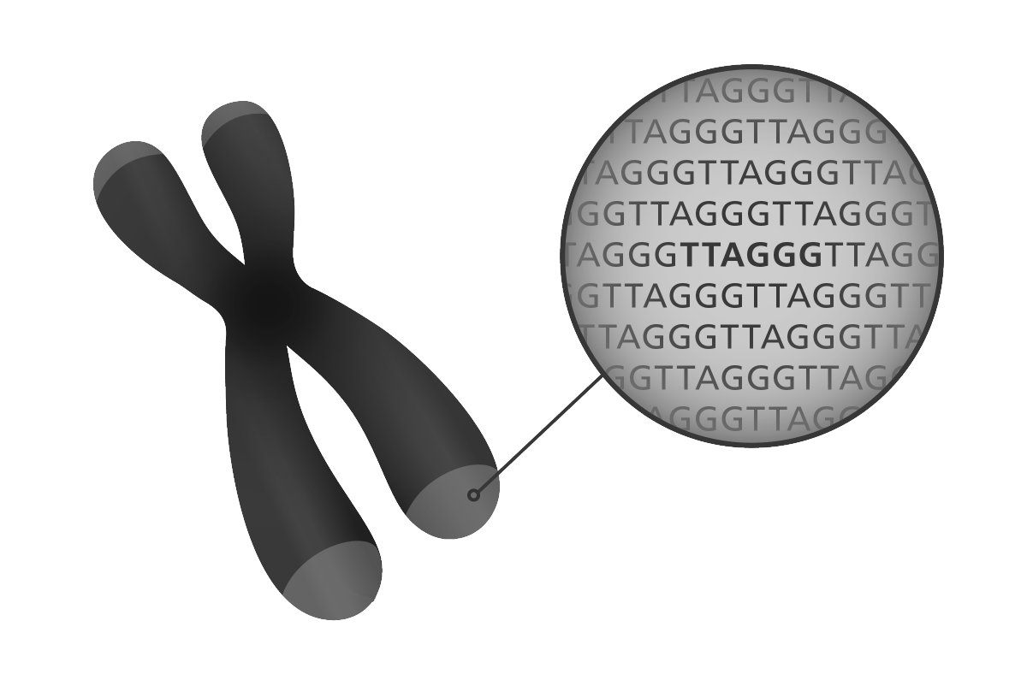
Genetic Algorithms
John Henry Holland
Fun Facts:
Received the first PhD in Computer Science awarded by Univ. of Michigan in 1959.
Named a MacArthur Fellow in 1992
Was PhD advisor to Edgar Codd

Slide 41
Genetic Algorithms
Put a little too simply, GAs involve using
a random number generator to get
“better”
answers to
“hard problems”
“quickly”.

Slide 42
Genetic Algorithms
Best suited for finding
“near optimal”
solutions to problems that have so many possible solutions that determining the true optimal would take
“too long” (like the TSP).

Slide 43
Genetic Algorithms
The main components of a GA are:

Slide 44
Genetic Algorithms
The main components of a GA are:
A goal function

Slide 45
Genetic Algorithms
The main components of a GA are:
A goal function
A “population” of “individuals” or “chromosomes”, implying an individual with a single haploid chromosome. (As opposed to humans and other mammals that have multiple diploid chromosomes.)

Slide 46
Genetic Algorithms
The main components of a GA are:
A goal function
A “population” of “individuals” or “chromosomes”, implying an individual with a single haploid chromosome. (As opposed to humans and other mammals that have multiple diploid chromosomes.)
Successive Generations, during each of which we apply:

Slide 47
Genetic Algorithms
The main components of a GA are:
A goal function
A “population” of “individuals” or “chromosomes”, implying an individual with a single haploid chromosome. (As opposed to humans and other mammals that have multiple diploid chromosomes.)
Successive Generations, during each of which we apply:
Selection

Slide 48
Genetic Algorithms
The main components of a GA are:
A goal function
A “population” of “individuals” or “chromosomes”, implying an individual with a single haploid chromosome. (As opposed to humans and other mammals that have multiple diploid chromosomes.)
Successive Generations, during each of which we apply:
Selection
Crossover

Slide 49
Genetic Algorithms
The main components of a GA are:
A goal function
A “population” of “individuals” or “chromosomes”, implying an individual with a single haploid chromosome. (As opposed to humans and other mammals that have multiple diploid chromosomes.)
Successive Generations, during each of which we apply:
Selection
Crossover
Mutation

Slide 50
Genetic Algorithms
The main components of a GA are:
A goal function
A “population” of “individuals” or “chromosomes”. With GAs, we use a single haploid chromosome to represent the entire individual. (As opposed to humans and other mammals that have multiple diploid chromosomes.)
Successive Generations, during each of which we apply:
Selection
Crossover
Mutation
A stopping condition

Slide 51
Genetic Algorithms
Common selection methods include:

Slide 52
Genetic Algorithms
Common selection methods include:
Elitism

Slide 53
Genetic Algorithms
Common selection methods include:
Elitism
(An unfair) Roulette Wheel

Slide 54
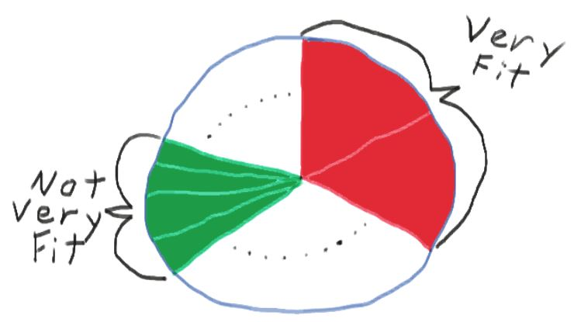
Genetic Algorithms
Common selection methods include:
Elitism
(An unfair) Roulette Wheel

Slide 55

Genetic Algorithms
Traditional Chromosome Encoding

Slide 56

Genetic Algorithms
Traditional Chromosome Encoding
0
1
1
0
1
0
0
1
1
1
0
1
0
1
1
0
0
1
0
1
1
0
0
0
1
0

Slide 57
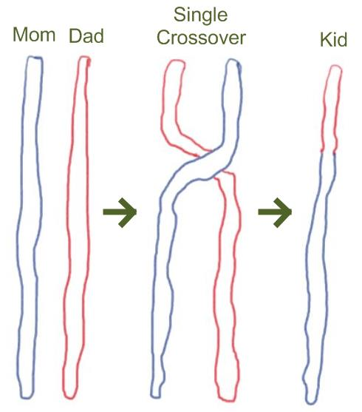
Genetic Algorithms
Traditional Single Point Crossover

Slide 58
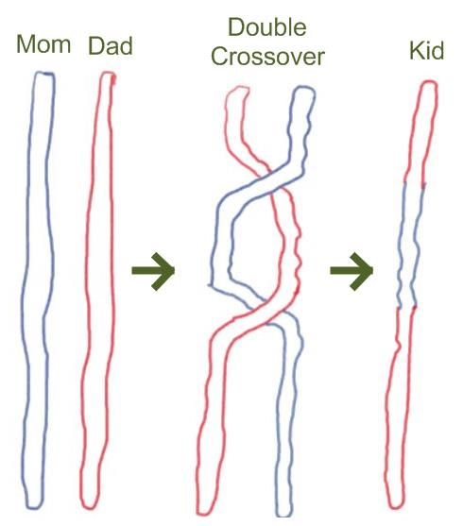
Genetic Algorithms
Traditional Double Point Crossover

Slide 59
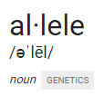
Genetic Algorithms
Mutation
In traditional GA solution encoding, we have a long list of bits that represent a solution.
So mutation is simple. Every once in a great while (the mutation rate), we just flip a bit.
This has the effect of introducing new alleles that may not have been present yet in any individual.
one of two or more alternative forms of a gene that arise by mutation and are found at the same place on a chromosome.

Slide 60
Genetic Algorithms
Traditional Single Crossover – Applied To Ordered Lists
Mom |  | Dad
D |  | E
F |  | D
B |  | G
E |  | H
C |  | J
G |  | B
A |  | A
I |  | I
J |  | F
H |  | C

Slide 61
Genetic Algorithms
Traditional Single Crossover – Applied To Ordered Lists
Mom |  | Dad |  | Kid
D |  | E |  | D
F |  | D |  | F
B |  | G |  | B | E ?
E |  | H |  | H | G ?
C |  | J |  | J
G |  | B |  | B
A |  | A |  | A
I |  | I |  | I
J |  | F |  | F
H |  | C |  | C

Slide 62
Genetic Algorithms
Traditional Mutation – Applied To Ordered Lists
D
F
B |  | ← ??
E
C
G | B
A
I
J
H

Slide 63
Genetic Algorithms
Crossover for the TSP – The Edge Recombination Operator (ERO)

Slide 64
Genetic Algorithms
Crossover for the TSP – The Edge Recombination Operator (ERO)
First published in 1989
Experimentally shown superior to the other methods for preserving the ordered list constraint of a TSP solution in 1999.

Slide 65
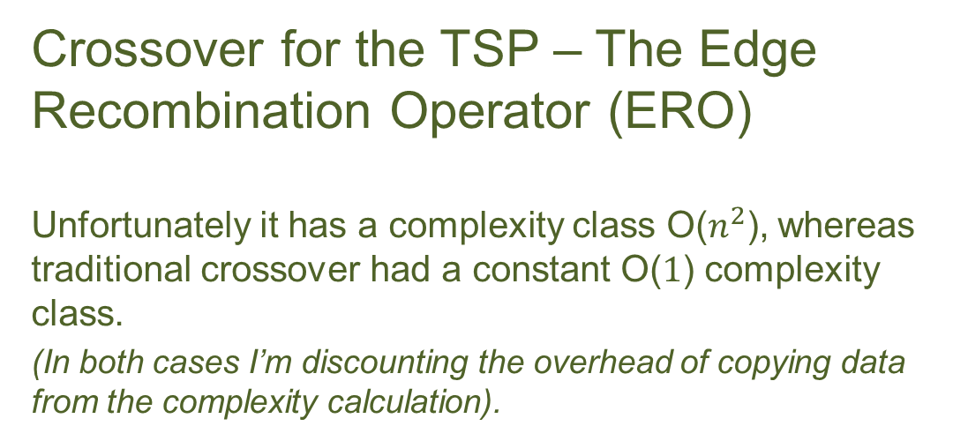
Genetic Algorithms
Crossover for the TSP – The Edge Recombination Operator (ERO)
Unfortunately it has a complexity class O($n^{2}$), whereas traditional crossover had a constant O($1$) complexity class.
(In both cases I’m discounting the overhead of copying data from the complexity calculation).

Slide 66
Genetic Algorithms
So are GAs a good way to solve the TSP?

Slide 67
Genetic Algorithms
So are GAs a good way to solve the TSP?
Encoding solutions is simple and space efficient

Slide 68
Genetic Algorithms
So are GAs a good way to solve the TSP?
Encoding solutions is simple and space efficient
Evaluating fitness, selection, and mutation are as computationally efficient as in any “traditional” GA

Slide 69
Genetic Algorithms
So are GAs a good way to solve the TSP?
Encoding solutions is simple and space efficient
Evaluating fitness, selection, and mutation are as computationally efficient as in any “traditional” GA
--but--
Crossover is relatively inefficient

Slide 70
Genetic Algorithms
So are GAs a good way to solve the TSP?
Encoding solutions is simple and space efficient
Evaluating fitness, selection, and mutation are as computationally efficient as in any “traditional” GA
--but--
Crossover is relatively inefficient
In general, maintaining the constraints of a viable solution to the TSP requires somewhat of a forced-fit onto the way GAs model natural selection.

Slide 71
Genetic Algorithms
“Wow! Modelling natural processes is neat!”

Slide 72
Genetic Algorithms
“Wow! Modelling natural processes is neat!”
“Is there a natural process that is by its very nature more like the TSP that we could model?”

Slide 73
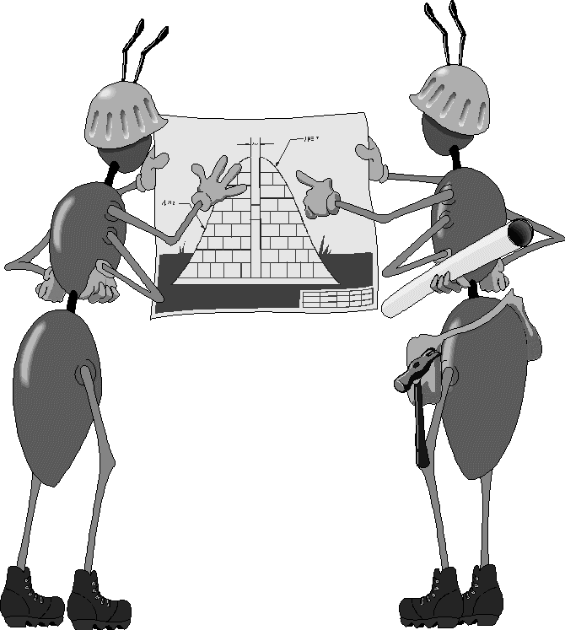
Ant Colony Optimization
Marco Dorigo
In his PhD thesis, in 1991, Marco Dorigo introduced the world to the first ant colony optimization algorithm, which he called “Ant System”.

Slide 74
Ant Colony Optimization
Marco Dorigo
In his PhD thesis, in 1991, Marco Dorigo introduced the world to the first ant colony optimization algorithm, which he called “Ant System”.
From the very first paper on ACOs, they were being used to solve TSP instances.

Slide 75
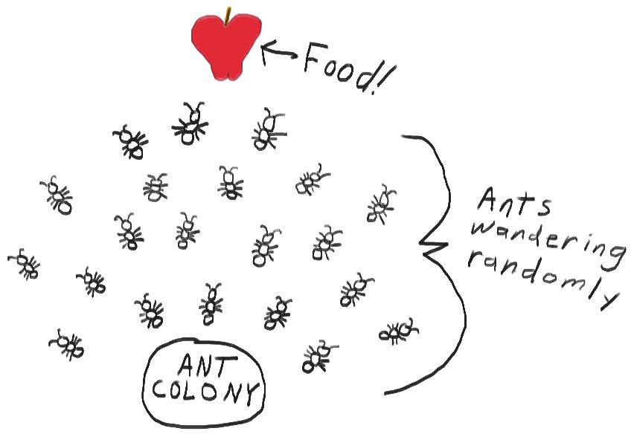
Ant Colony Optimization

Slide 76
Ant Colony Optimization
Similarities between GAs and ACOs

Slide 77
Ant Colony Optimization
Similarities between GAs and ACOs
Both use a population of individuals

Slide 78
Ant Colony Optimization
Similarities between GAs and ACOs
Both use a population of individuals
Both run over a series of generations (GA terminology) or iterations (ACO terminology)

Slide 79
Ant Colony Optimization
Similarities between GAs and ACOs
Both use a population of individuals
Both run over a series of generations (GA terminology) or iterations (ACO terminology)
In both bases, those numbers (size of population and number of generations/iterations) tend to be smaller for ACOs than GAs in order to achieve similar results.

Slide 80
Ant Colony Optimization
Differences between GAs and ACOs

Slide 81
Ant Colony Optimization
Differences between GAs and ACOs
The individuals (ants) in ACOs don’t change thru the iterations …they are agents, not encoded solutions.

Slide 82
Ant Colony Optimization
Differences between GAs and ACOs
The individuals (ants) in ACOs don’t change thru the iterations …they are agents, not encoded solutions.
The individuals are co-operating rather than competing

Slide 83
Ant Colony Optimization
Differences between GAs and ACOs
The individuals (ants) in ACOs don’t change thru the iterations …they are agents, not encoded solutions.
The individuals are co-operating rather than competing
The “intelligence” isn’t encoded in the genes of the individuals but rather laid on the graph as pheromones

Slide 84
Ant Colony Optimization
Differences between GAs and ACOs
The individuals (ants) in ACOs don’t change thru the iterations …they are agents, not encoded solutions.
The individuals are co-operating rather than competing
The “intelligence” isn’t encoded in the genes of the individuals but rather laid on the graph as pheromones
ACOs are by their nature graph-based. Paths, edges and vertices are inherent. (The TSP is a graph problem where paths are routes, edges are the roads between cities and vertices are the cities.)

Slide 85
Ant Colony Optimization
ACOs At A High Level
We start with a small number of ants (typically 10-20).

Slide 86
Ant Colony Optimization
ACOs At A High Level
We start with a small number of ants (typically 10-20).
Step by step (city by city) they each probabilistically choose what edge to take (what city to go to next).

Slide 87
Ant Colony Optimization
ACOs At A High Level
We start with a small number of ants (typically 10-20).
Step by step (city by city) they each probabilistically choose what edge to take (what city to go to next).
After they’ve all created a tour, we:

Slide 88
Ant Colony Optimization
ACOs At A High Level
We start with a small number of ants (typically 10-20).
Step by step (city by city) they each probabilistically choose what edge to take (what city to go to next).
After they’ve all created a tour, we:
Lay down pheromones along the edges each ant took.

Slide 89
Ant Colony Optimization
ACOs At A High Level
We start with a small number of ants (typically 10-20).
Step by step (city by city) they each probabilistically choose what edge to take (what city to go to next).
After they’ve all created a tour, we:
Lay down pheromones along the edges each ant took.
Evaporate the pheromones.

Slide 90
Ant Colony Optimization
ACOs At A High Level
We start with a small number of ants (typically 10-20).
Step by step (city by city) they each probabilistically choose what edge to take (what city to go to next).
After they’ve all created a tour, we:
Lay down pheromones along the edges each ant took.
Evaporate the pheromones.
We repeat this process until we reach a stopping condition (often simply a number of iterations).

Slide 91
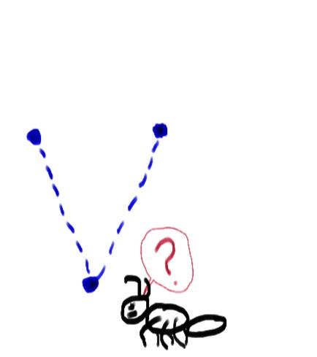
Ant Colony Optimization

Slide 92
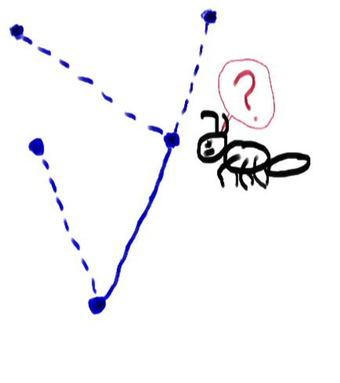
Ant Colony Optimization

Slide 93
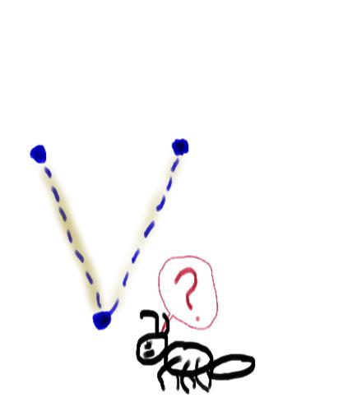
Ant Colony Optimization

Slide 94
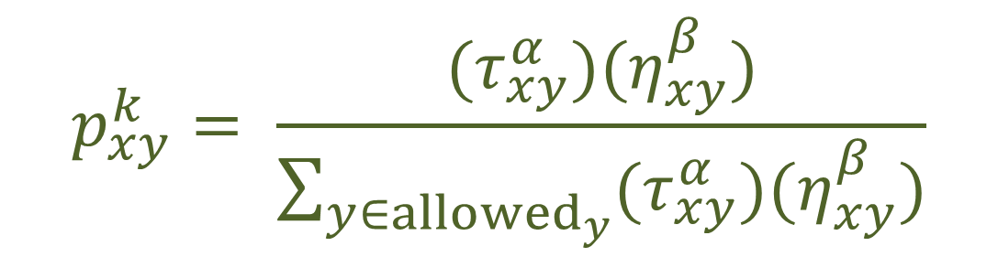
Ant Colony Optimization
Probability of choosing a remaining edge
$$p_{xy}^{k}= \frac{{(τ}_{xy}^{α})(η_{xy}^{β})}{\sum_{y∈{allowed}_{y}}{{(τ}_{xy}^{α})(η_{xy}^{β})}}$$
(Equation 1)

Slide 95

Ant Colony Optimization
What would $τ$ look like?

Slide 96
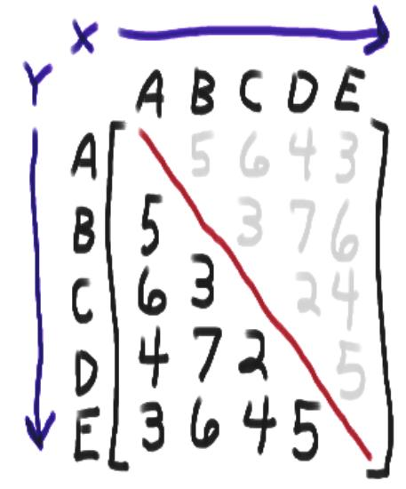
Ant Colony Optimization
What would $τ$ look like?

Slide 97

Ant Colony Optimization
What would $η$ look like?

Slide 98
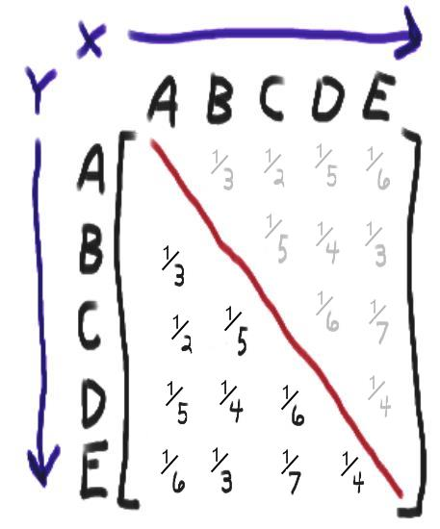
Ant Colony Optimization
What would $η$ look like?

Slide 99
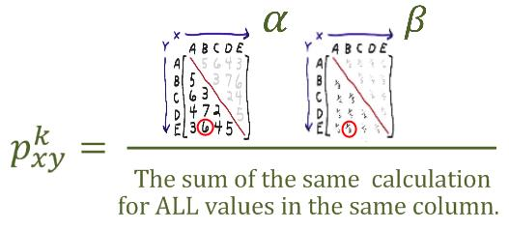
Ant Colony Optimization
Probability of choosing a remaining edge
(Equation 1)

Slide 100
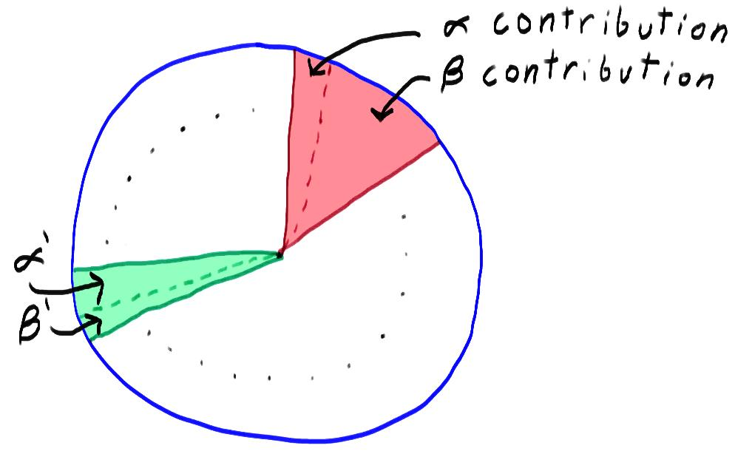
Ant Colony Optimization

Slide 101
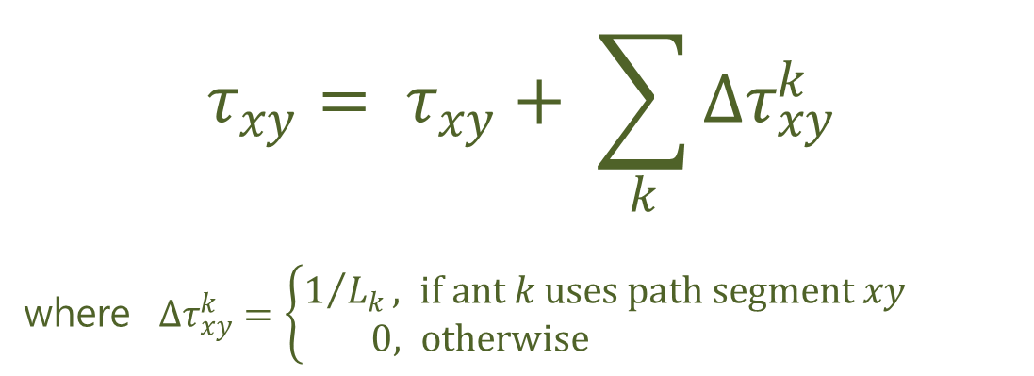
Ant Colony Optimization
Updating the pheromones along the edges
$$τ_{xy}= τ_{xy}+ \sum_{k}{∆τ_{xy}^{k}}$$
where $∆τ_{xy}^{k}=\left\{\begin{aligned}1/{L_{k}}, if ant k uses path segment xy \\ 0, otherwise \end{aligned}\right.$
(Equation 2)

Slide 102

Ant Colony Optimization
Evaporating the pheromones
$$τ_{xy}= τ_{xy}(1−ρ)$$
(Equation 3)

Slide 103
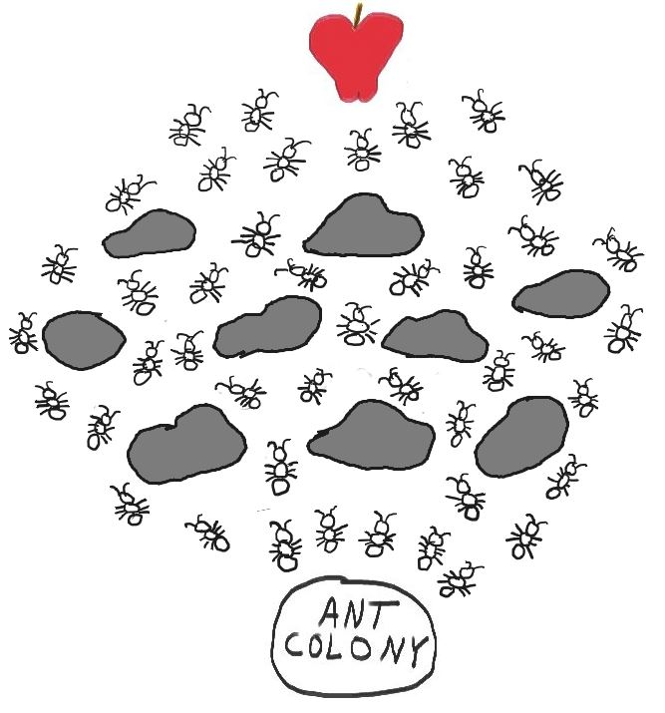
Ant Colony Optimization
Obstacles
What makes all of this non-trivial (i.e. not a straight line) and what allows for it to naturally model the TSP

Slide 104
Ant Colony Optimization
Extensions to ACO

Slide 105
Ant Colony Optimization
Extensions to ACO
Ant Colony System (ACS) – introduced q0, which is a percentage (often 10%) chance, at any step, to bypass the probabilistic equation 1 for choosing the next city, and instead go directly to the city closest to the current one.

Slide 106
Ant Colony Optimization
Extensions to ACO
Ant Colony System (ACS) – introduced q0, which is a percentage (often 10%) chance, at any step, to bypass the probabilistic equation 1 for choosing the next city, and instead go directly to the city closest to the current one.
Max-Min Ant System (MMAS) – introduced maximum and minimum values for the pheromone trails along all edges.
(both introduced in 1996)

Slide 107
Ant Colony Optimization
Interestingly…
Theoretically, but not practically at this point, in 2002 it was proven that certain ACO algorithms (including the ACS and MMAS extensions) will eventually converge to the true optimal value.
Unfortunately, there is no way to predict how long that will take (yet)…

Slide 108
Ant Colony Optimization
Questions?

Slide 109

Thanks!
Adam Byerly
adam@rokrol.com
(309) 369-9257

